Slide 1
GitHub OAUth2
Using Haskell’s Yesod-Stack
By Jared Magrath

Slide 2
GitHub OAuth
The aim of these slides is to illustrate how to incorporate OAuth into web applications, provide a perspective as a client OAuth receiving an access token and lastly to highlight the sort of information that can be obtained once an access token has been received by a client application.
OAuth stands for Open Authentication protocol and allow for secure data sharing. The slides will demonstrate how to set up an OAuthentication using Haskell’s yesod web framework for Githubs API.

Slide 3
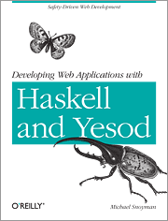
Yesod web framework
The Yesod web framework allows for an easier web frame setup when using Haskell.
The Stack-Yesod framework enables for templates of projects to be easily altered for one’s use.

Slide 4

yesod-sqlite
For purposes of this demonstration, the Yesod-sqlite project template was chosen.
The project template comes with a number of extra components to enable basic OAuth with a dummy website.

Slide 5
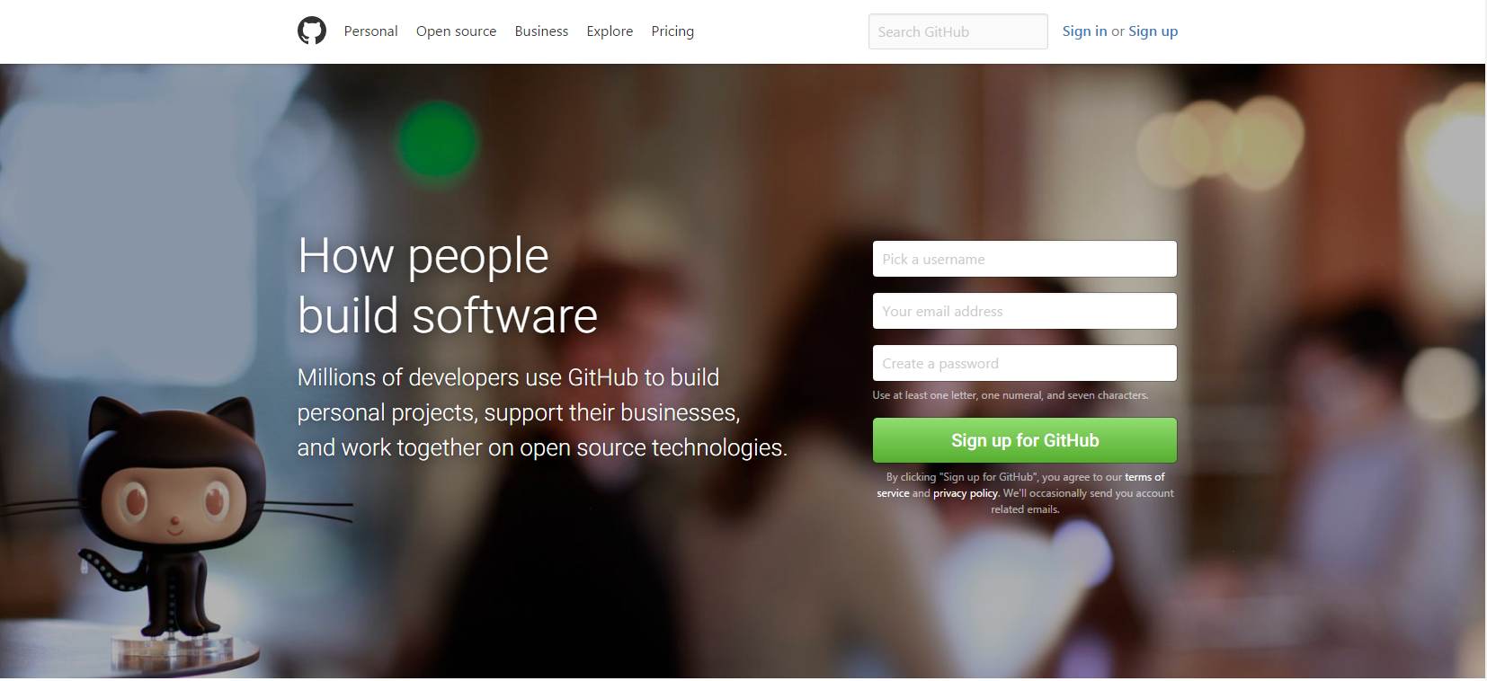
Getting Your Client ID and Secrets from GitHub
In your GitHub settings you can set-up a Developer application for OAuth, and obtain a client ID and client secret. This allows the API to verify who the application belongs to (which client application is asking for an access token).
clientId :: Text
clientId = “XXXXXXXXXXXXXXXXXXXXX"
clientSecret :: Text
clientSecret = “XXXXXXXXXXXXXXXXXXXXXXXXX"

Slide 6
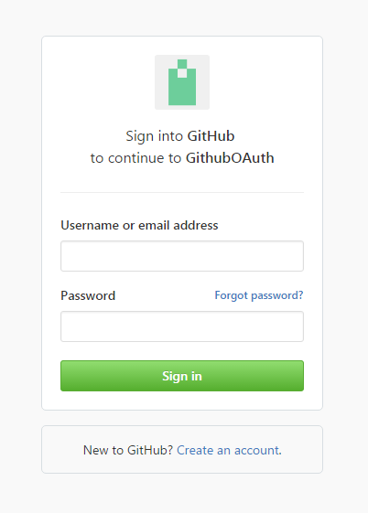
Inserting Your Client ID and Secret into and enabling Github Oauth in Stack
Using the Foundation file in stack you can paste in your client Id and Secret. Similarly, by editing authPlugins app to use the Github Oauth2 package to take in your clientID and ClientScret.
After adding the external dependencies you should be able to access the Github OAuth service when running stack and going to localhost:3000/profile. This will load the Github OAuth API and prompt any user of the application to input their security details.

Slide 7
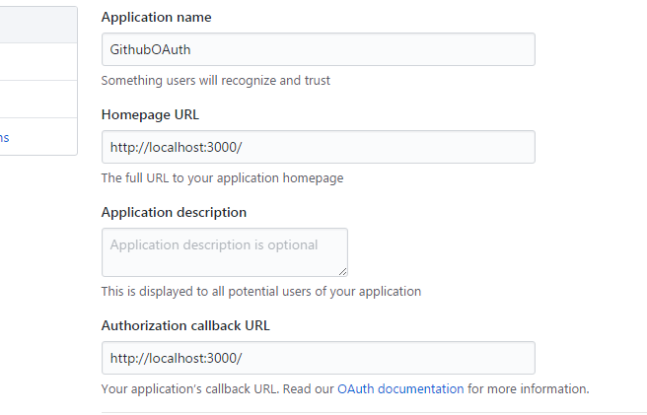
GitHUb Redirect To the yesod application
After an user has logged into the Yesod Web application, the Github authentication manager will the redirect him/her to the callback URL defined by the developer (in this case http://localhost:3000/).

Slide 8
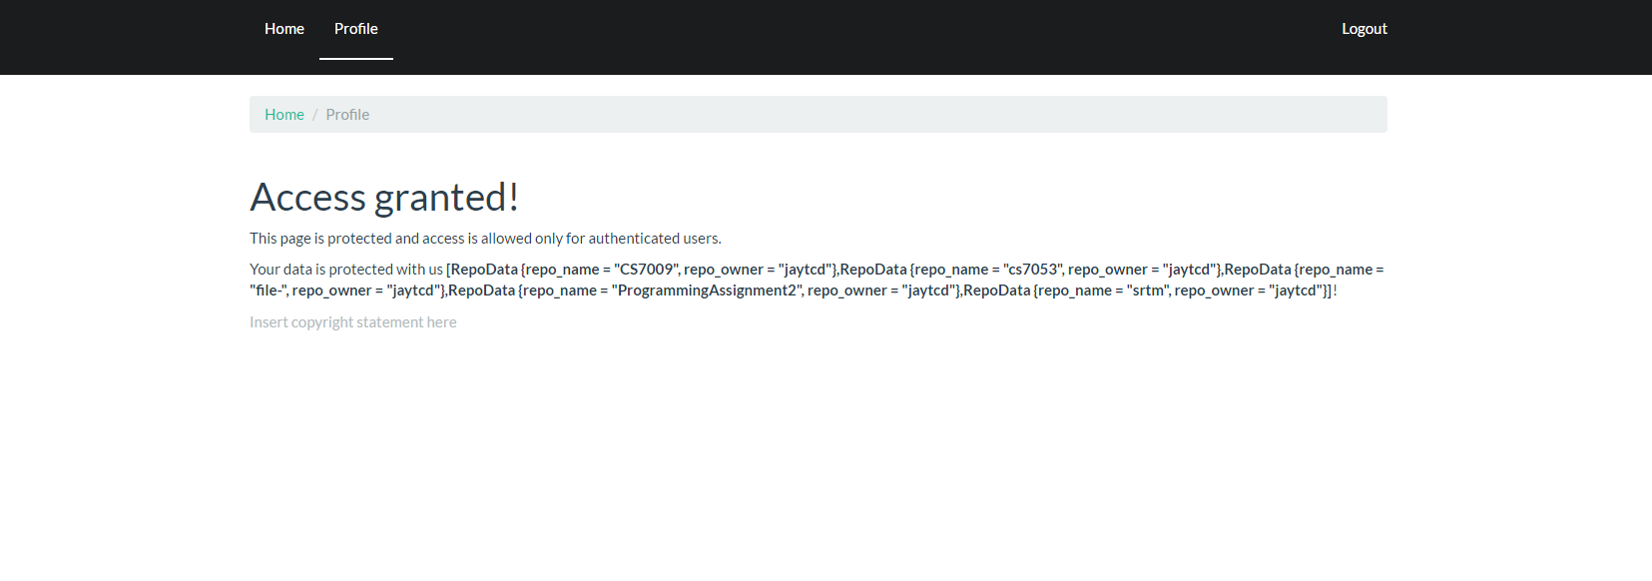
Getting user Information
Thereafter, the access token will be returned to the application. The application can now use to access the users information.
By editing the profile file in the handler folder of your stack project, you should be able to retrieve information from other Github API using the user’s access token.
As seen on the left, where my repository data was displayed after the login and access token stages had been completed.

Slide 9
Understanding the Steps
To understand the different steps performed by the Yesod-Web application (using OAuth), the slides by Phil Hunt have been edited.

Slide 10

Protocol Flow
Authentication Service
AM triggers user authentication
Yesod Web Application
Github Authorization Manager
Redirect the user/browser to the Github OAuth manager with the client_id and clientSecret. The webpage is then redirected to the server’s (Github’s Authentication service).
Resource Server
Anonymous
Authenticated
Token

Slide 11
Protocol Flow
Authentication Service
AM asks user for consent
Yesod Web Application
Github Authorization Manager
Resource Server
Anonymous
Authenticated
Token

Slide 12
Protocol Flow
Authentication Service
Yesod Web Application
Github Authorization Manager
Response is returned with grant code to localhost:3000/
Resource Server
Anonymous
Authenticated
Token

Slide 13
Protocol Flow
Authentication Service
Yesod Web Application
App
Github Authorization Manager
In background (non-browser) using the authentication cred of the client app (the Yesod web application), the code, and client_id are exchanged for an access token via HTTP POST*
Resource Server
Anonymous
Authenticated
Token

Slide 14
Protocol Flow
Authentication Service
Yesod Web Application
App
Github Authorization Manager
The Yesod Web application now has access to Github resource using OAuth token in Authorization header
Resource Server
Anonymous
Authenticated
Token

Slide 15
References
Barrett, S. (2017). CS7009. [online] Scss.tcd.ie. Available at: https://www.scss.tcd.ie/Stephen.Barrett/lectures/cs7009/.
Yesodweb.com. (2017). Authentication and Authorization :: Yesod Web Framework Book- Version 1.4. [online] Available at: http://www.yesodweb.com/book/authentication-and-authorization.
https://hackage.haskell.org/package/github-0.13.2
https://github.com/phadej/github
Introduction to OAuth2z. Phil Hunt. Oracle Corporation. March 2016. @independentid. phil.hunt@oracle.com

